Slide 1
TIME SERIES ON ENERGY CONSUMPTION
CA2 PART A – TIME SERIES FORECASTING
Name : Dario Prawara Teh Wei Rong
Class : DAAA / FT / 2A / 04

Slide 2

PROJECT OBJECTIVE
Objective of Time Series Analysis
Using the Energy Consumption dataset, train time series models and forecast the gas consumption, electricity consumption, and water consumption in the future.
Background Information of Analysis
The time series model is built using the Energy Consumption Dataset.csv, with a ‘Date’ value column, and the relevant data for gas, electricity and water consumption.

Slide 3
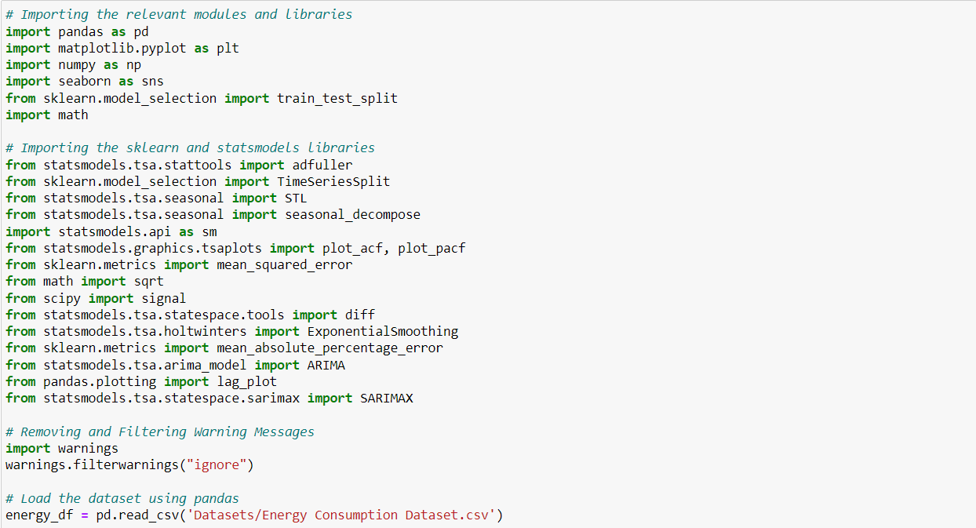
IMPORTING MODULES
Import the necessary modules for data exploration, preprocessing, and forecasting models.
Import the csv energy consumption dataset file using pandas : pd.read_csv.

Slide 4
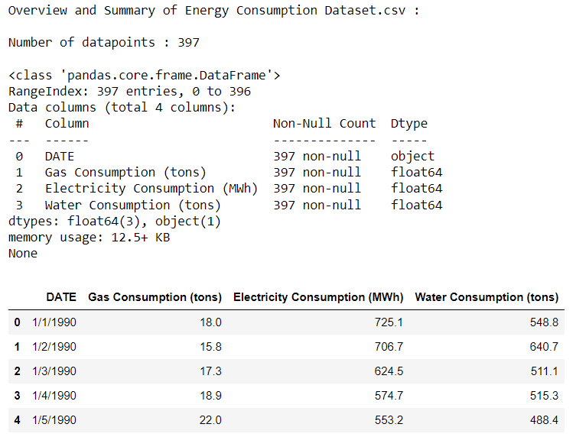
UNDERSTANDING THE DATA
To wrangle the dataset, apply the len() function to obtain the number of datapoints in the dataset : 397.
Use pandas function .info() to obtain information on the object and data structure (type, size, content) of the energy consumption dataset.
View the first 5 rows of the dataset using .head(). Based on the overview, we need to set ‘DATE’ column as the index of the dataset to enable time-based indexing.

Slide 5
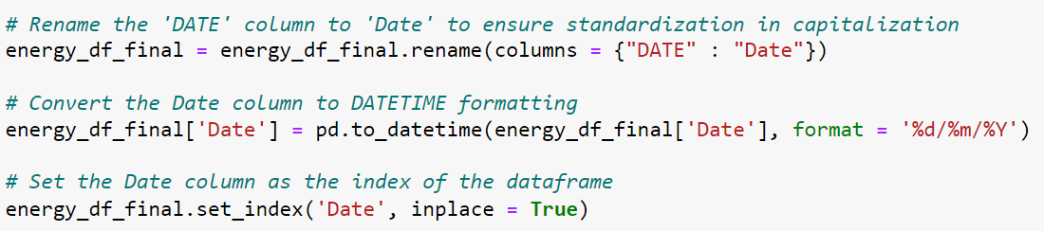
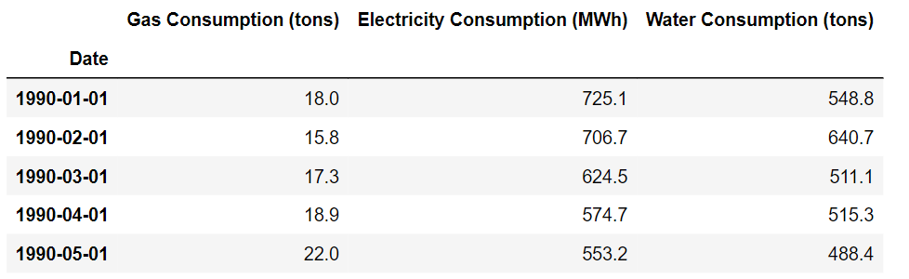
DATA PREPROCESSING
To ensure consistency, use pandas .rename() to standardize the capitalization for column names.
Convert the date column to DATETIME formatting %d/%m/%Y to enable time series forecasting.
Set the ‘Date’ column as the index of the data frame using .set_index() to allow time-based indexing and operations.

Slide 6
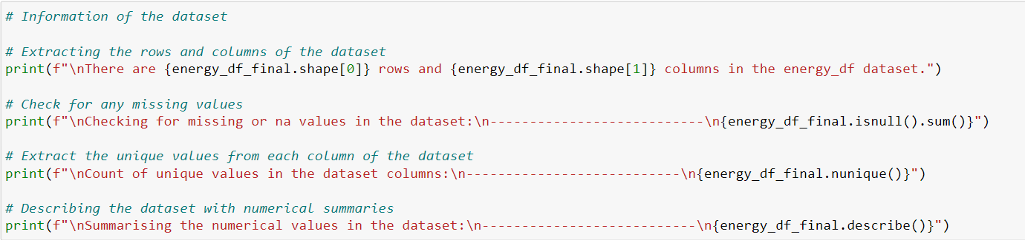
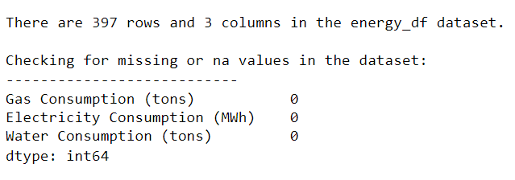
DESCRIBING THE DATA
Energy consumption dataset contains 397 rows and 3 columns.
Check that the dataset does not contain any NULL / NA values using .isnull().sum().
Used .nunique() to retrieve the number of unique values in each data column.
Use .describe() for numerical columns and return values of descriptive statistics like count and mean.

Slide 7
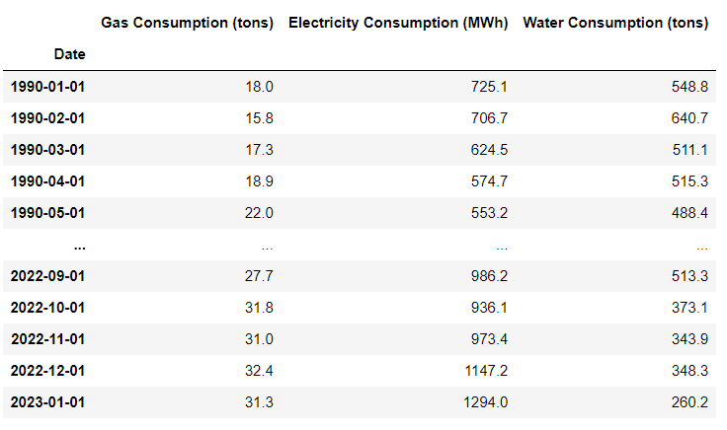
OVERVIEW OF FINAL DATASET

Slide 8
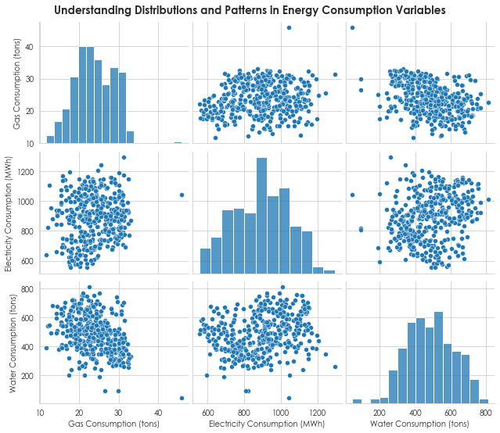
DATA EXPLORATION
Normalized Distributions: The pair plot reveals relatively normalized gas, electricity, and water consumption distributions with minimal outliers, indicating consistent and stable energy usage patterns.
Absence of Correlation: The scatterplots shows no significant correlations or patterns between energy consumption variables, implying that the dataset does not contain any exogenous variables.
The lack of a pattern suggests a degree of independence between the variables, with each energy source being driven by its own unique factors.

Slide 9
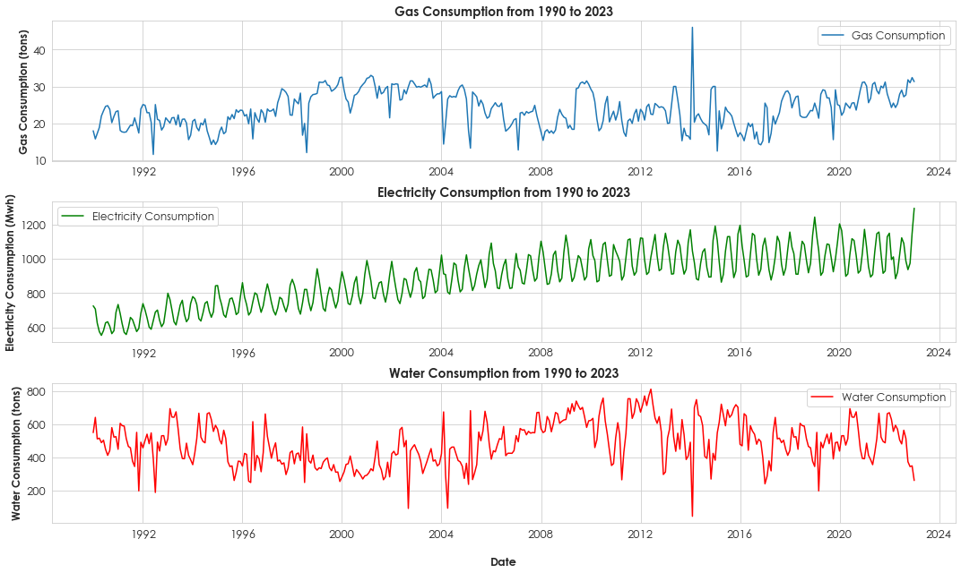
DATA EXPLORATION
Energy Fluctuations: Fluctuations in energy consumption for gas, electricity, and water result from dynamic influences like weather, technology advancements, and consumer behavior shifts.
Seasonal Patterns: Evident cycles in energy use for gas, water, and electricity indicate seasonal demand variations, aiding resource allocation and highlighting suitability of SARIMA modeling.
Electricity Growth: Consistent electricity consumption rise from 1990 to 2023 is linked to expanding technology use and urbanization-driven energy demand.

Slide 10
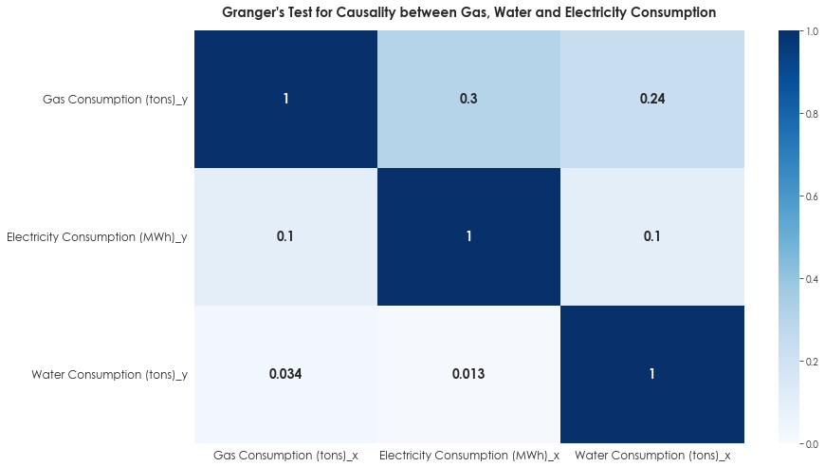
DATA EXPLORATION
Based on the Granger Causality Test, if the correlation coefficient is less than p = 0.05, we reject the null hypothesis and conclude that the x-value will Granger-cause the y-value.
From the plot, we see that only when ‘Water Consumption (tons)’ is a causal variable, it could Granger-cause gas and electricity consumption and changes in water consumption could Granger-cause changes in electricity and gas.
However, for gas and electricity consumption as a causal variable, the correlation coefficient is > 0.05, hence indicating the lack of causality and a causal relationship between variables.

Slide 11
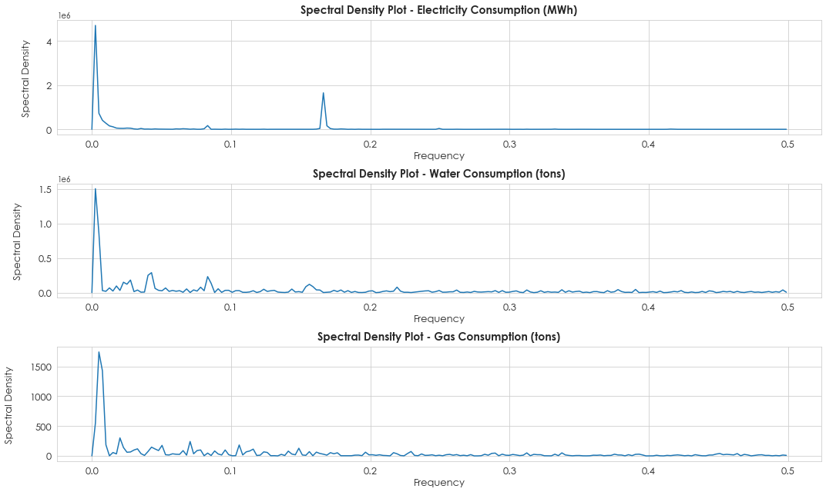
DATA EXPLORATION
Based on the spectral density plot, it can be observed that the energy consumption variables demonstrate clear periodicity due to flat portions of the plot indicating clear and consistent periodic behavior.
However, the electricity consumption plot indicates a notable secondary peak at 0.17 frequency, signifying added variability and potential non-stationarity.
Hence, stationarity transformation is needed for improved analysis and modeling reliability.

Slide 12
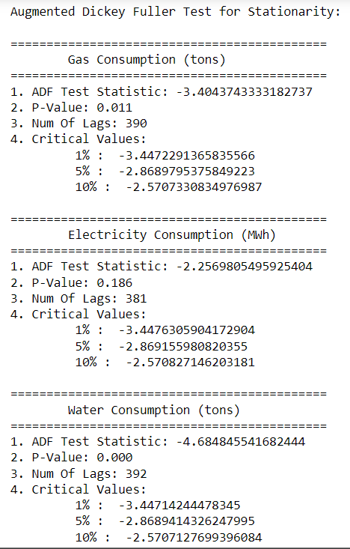

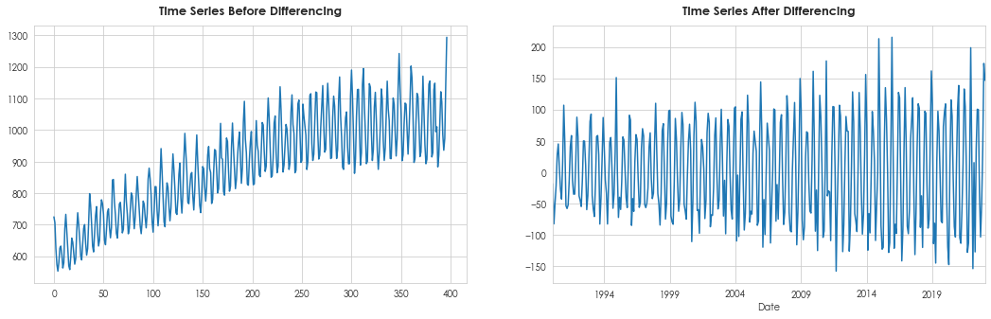
FEATURE ENGINEERING
To check stationarity, use ADF test to check the P-Value for the column.
Based on the ADF test, it is clear only Electricity Consumption (MWh) is not stationary with a P-Value of 0.186 > 0.05 (benchmark).
To apply stationarity to the electricity column, first-order differencing is applied where k_diff = 1.
After differencing, the p-value dropped to 0, and has eliminated any trends and irregularities from the electricity consumption data.

Slide 13
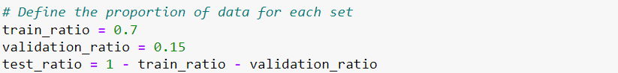

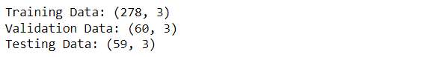
FEATURE ENGINEERING
Define 70% of the data for train data, 15% for validation data, and the rest for test data to ensure sufficient data for testing and maintaining consistent data splits.
Split the dataframe accordingly and use iloc[] to subset and select the relevant rows for each set.
From here, we see that the training data has 278 rows, validation data has 60 rows and testing data has 59 rows.

Slide 14
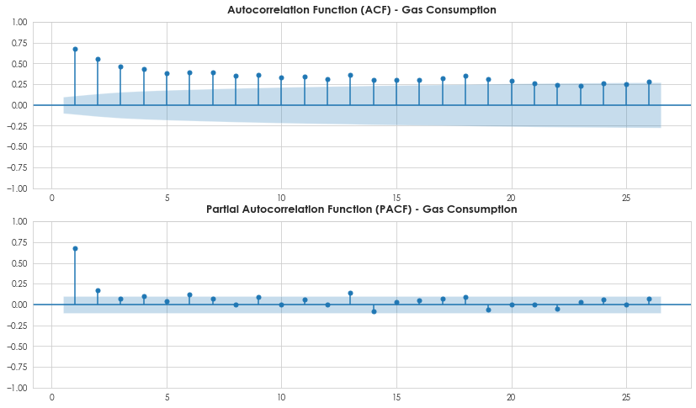
MODEL TESTING & SELECTION
GAS CONSUMPTION (TONS)
The ACF plot determines the MA(q) process, and the PACF plot determines the AR(p) process.
From the ACF plot, it has relatively significant spikes at lag 1 and lag 2, possibly indicating that an MA(2) process is suitable for gas consumption.
From the PACF plot, it only has one clear significant spike at lag 1, indicating that an AR(1) process is suitable for gas consumption.
So, the plots suggest that p = 1 and q = 2.

Slide 15

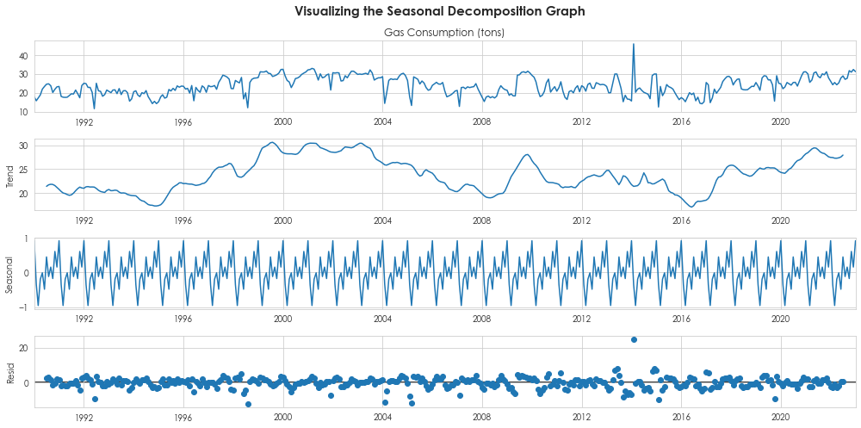
MODEL TESTING & SELECTION
GAS CONSUMPTION (TONS)
To determine seasonality, use the ‘seasonal_decompose’ function to plot the seasonal decomposition plot.
Specify model as ‘additive’ as patterns in seasonality remain similar throughout.
Based on the seasonal plot, we can identify that the seasonal period for gas consumption = 12. To validate this, we will plot an ACF seasonal plot next.

Slide 16

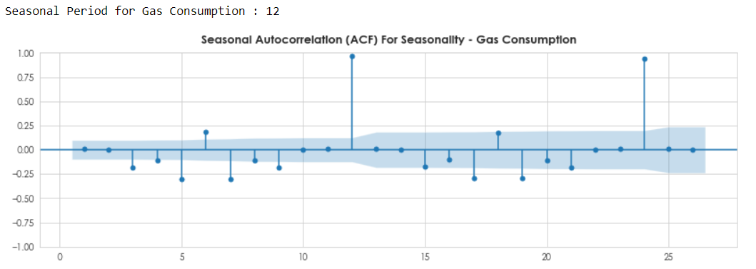
MODEL TESTING & SELECTION
GAS CONSUMPTION (TONS)
For this plot, significant spikes that extend beyond the blue significance bands indicate the presence of seasonal patterns.
The plot shows that the spike occurs at period 12, indicating that the seasonal period for gas consumption is indeed 12.
Plot a seasonal ACF plot to validate the seasonal period for gas consumption.

Slide 17
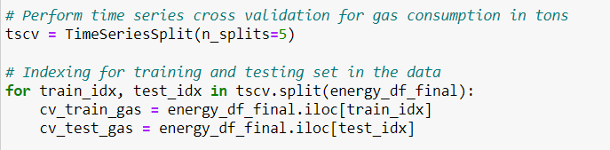
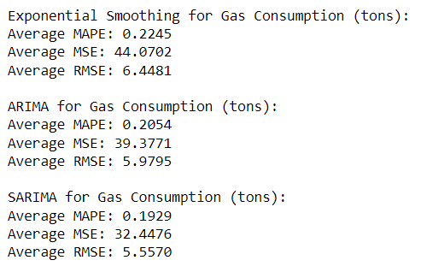
MODEL CROSS VALIDATION
GAS CONSUMPTION (TONS)
To identify the most suitable model, use cross-validation (Time Series Split) where cv = 5 and retrieve the average error rates for each of the models.
Index and split the data into training and validation sets for cross-validation.
From the output, SARIMA model had the lowest error rates of all, with a MAPE of 19%, MSE of 32 and RMSE of 5.55.

Slide 18
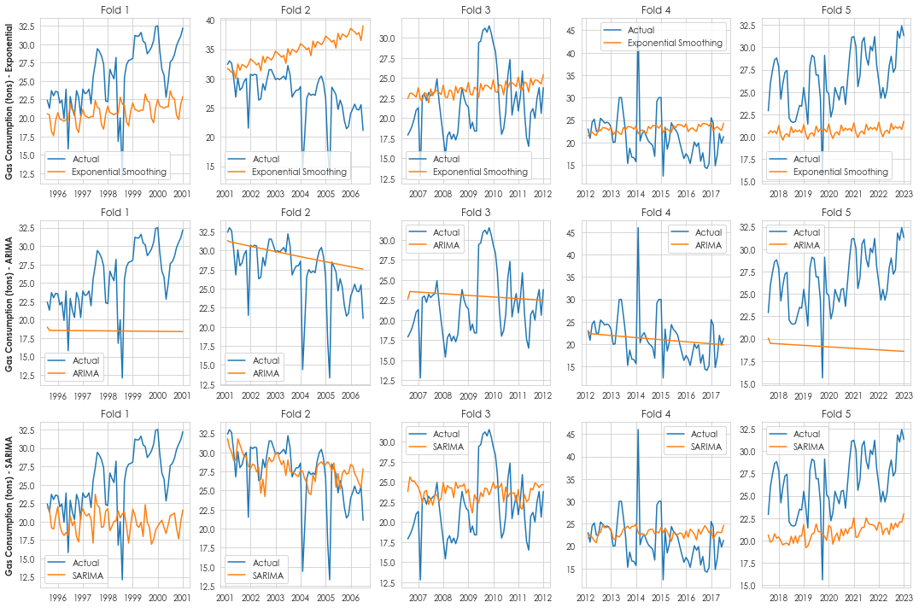
MODEL CROSS VALIDATION
GAS CONSUMPTION (TONS)
From the plots for Exponential Smoothing, ARIMA and SARIMA, we see that the predicted values for SARIMA best align with the actual values of gas consumption, following the trend better than the other two models across 5 folds.
This proves that SARIMA is the best model for forecasting gas consumption.

Slide 19

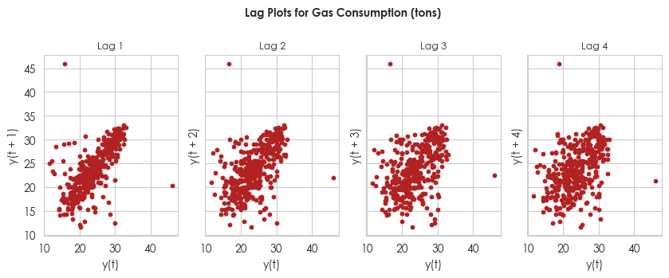
DETERMINE AUTOCORRELATION
GAS CONSUMPTION (TONS)
To identify any recurring patterns or autocorrelation within the data, use lag plots to visualize the relationship at specified time intervals.
The lag plots prove that the gas consumption data has positive autocorrelation, as there is a positively sloped line for all the lag values.
As the number of lags increase, the clusters consistently causes the points to spread away from each other, indicating repeating patterns and seasonality in the data.

Slide 20
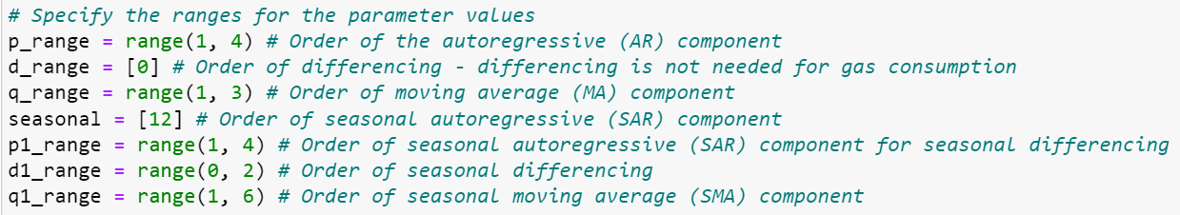
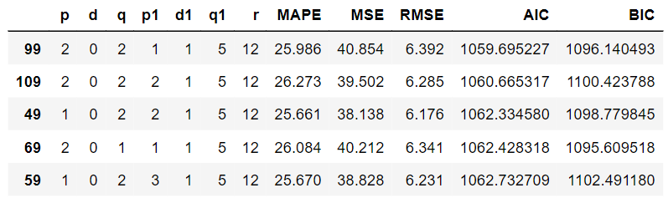
HYPERPARAMETER TUNING
GAS CONSUMPTION (TONS)
Tune the SARIMA Model for ‘Gas Consumption (tons)’ by looping through p, d, q, r, p1, d1, q1 values and obtain the error metrics using validation data.
Sort the results obtained by increasing AIC values.
From the results, (2, 0, 2), (1, 1, 5, 12) provides the best AIC value of 1059.69. However, we will still analyse further before deciding on the optimal order.

Slide 21
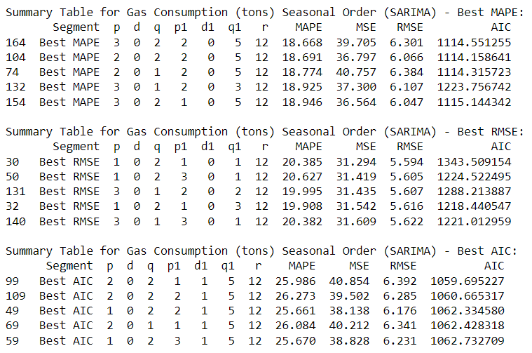
HYPERPARAMETER TUNING
GAS CONSUMPTION (TONS)
Further sort the tuned results by RMSE, MAPE and AIC.
BIC was not used to sort the data as it is more important to reduce error rates and identify good predictive models in the analysis (AIC).
From this table, we will still decide to keep the set of results with the lowest AIC of 1059.69 as it represents the best trade-off between model complexity and goodness of fit and prevents overfitting of data.

Slide 22
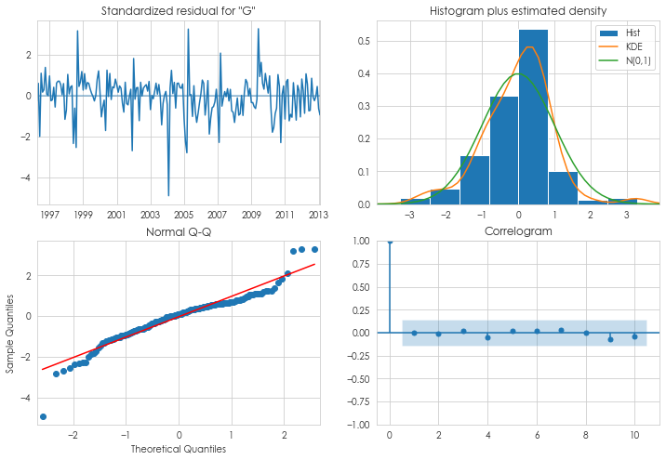
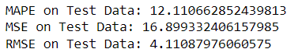
FINAL MODEL EVALUATION
GAS CONSUMPTION (TONS)
Evaluation Metrics :
From the evaluation metrics, we can see that the set order (2, 0, 2), (1, 1, 5, 12) was a good choice as error rates are all kept very low.
From the plots, the standardized residual should show no pattern.
The KDE and N[0,1] plot should look similar.
The scatter points should pass through the line for the Normal Q-Q plot.
The correlogram should have all points within the shaded area except from its first point.

Slide 23

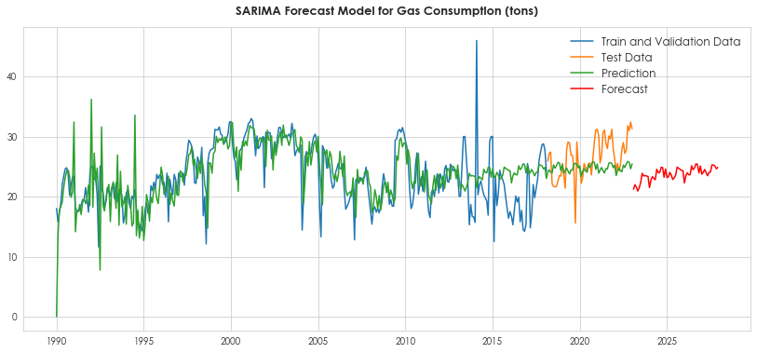
FINAL FORECAST MODEL
GAS CONSUMPTION (TONS)
Generate predictions using the tuned SARIMA model for the time range from 1990 to 2023.

Slide 24
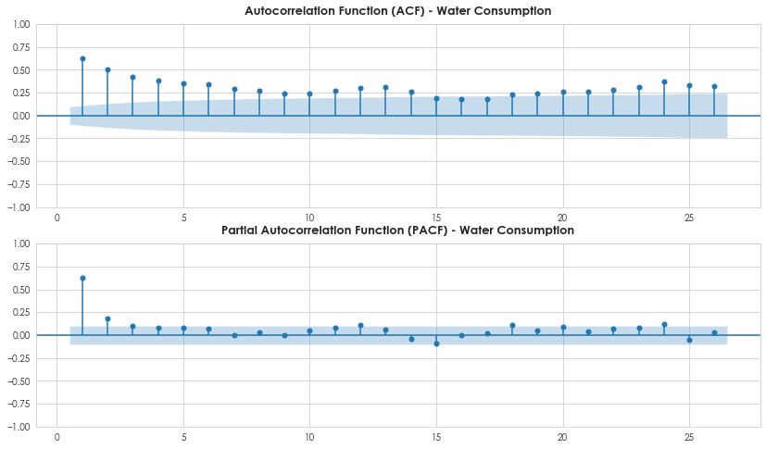
MODEL TESTING & SELECTION
WATER CONSUMPTION (TONS)
The ACF plot determines the MA(q) process, and the PACF plot determines the AR(p) process.
From the ACF plot, it has relatively significant spikes at lag 1 and lag 2, possibly indicating that an MA(2) process is suitable for gas consumption.
From the PACF plot, it only has one clear significant spike at lag 1, indicating that an AR(1) process is suitable for gas consumption.
So, the plots suggest that p = 1 and q = 2.

Slide 25

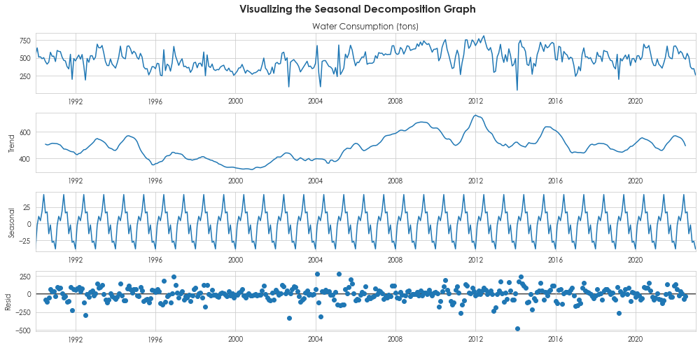
MODEL TESTING & SELECTION
WATER CONSUMPTION (TONS)
To determine seasonality, use the ‘seasonal_decompose’ function to plot the seasonal decomposition plot.
Specify model as ‘additive’ as patterns in seasonality remain similar throughout for water consumption.
Based on the seasonal plot, we can identify that the seasonal period for water consumption = 12. To validate this, we will plot an ACF seasonal plot next.

Slide 26

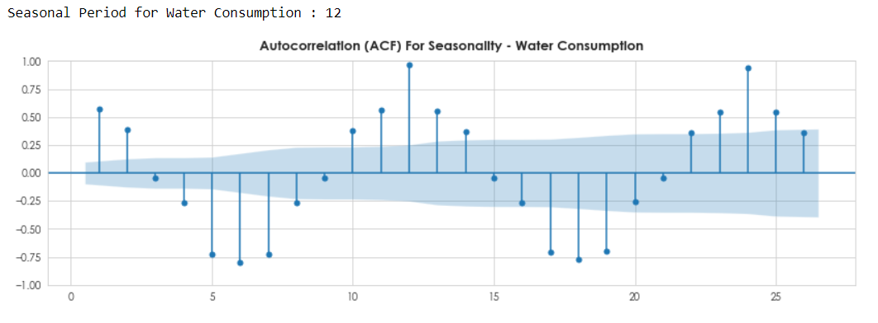
MODEL TESTING & SELECTION
WATER CONSUMPTION (TONS)
For this plot, significant spikes that extend beyond the blue significance bands indicate the presence of seasonal patterns.
The plot shows that the spike occurs at period 12, indicating that the seasonal period for water consumption is indeed 12.
Plot a seasonal ACF plot to validate the seasonal period for water consumption.

Slide 27
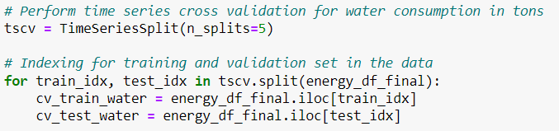
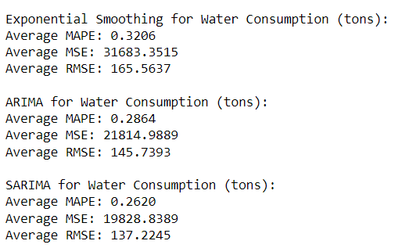
MODEL CROSS VALIDATION
WATER CONSUMPTION (TONS)
To identify the most suitable model, use cross-validation (Time Series Split) where cv = 5 and retrieve the average error rates for each of the models.
Index and split the data into training and validation sets for cross-validation.
From the output, SARIMA model had the lowest error rates of all, with a MAPE of 26%, MSE of 19828 and RMSE of 137.

Slide 28
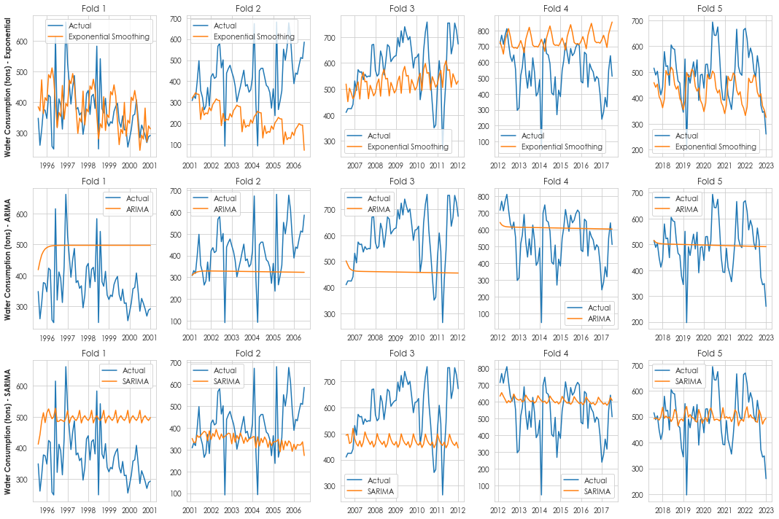
MODEL CROSS VALIDATION
WATER CONSUMPTION (TONS)
From the plots, we see that the predicted values for Exponential Smoothing best align with the actual trends for water consumption, followed by SARIMA.
However, we will still choose to use SARIMA as the metrics provided a much lower MAPE, MSE and RMSE score, indicating that SARIMA is still better for forecasting future values of water consumption and should be chosen for evaluation.

Slide 29

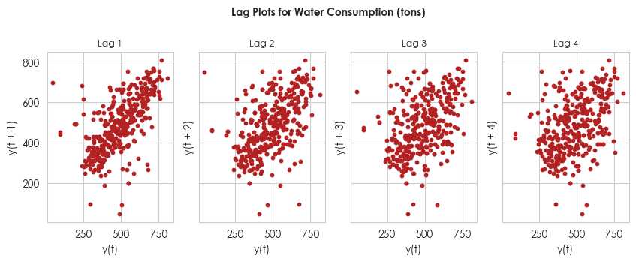
DETERMINE AUTOCORRELATION
WATER CONSUMPTION (TONS)
To identify any recurring patterns or autocorrelation within the data, use lag plots to visualize the relationship at specified time intervals.
The lag plots prove that the gas consumption data has positive autocorrelation, as there is a positively sloped line for all the lag values for water consumption data.
As the number of lags increase, the clusters consistently causes the points to spread away from each other, indicating repeating patterns and seasonality in the data.

Slide 30
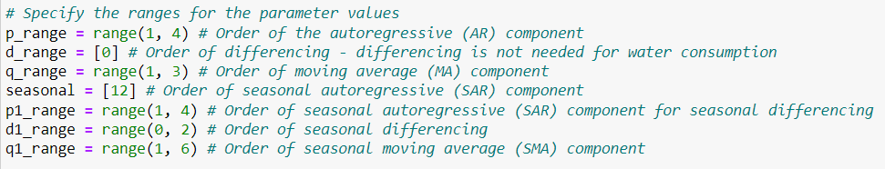
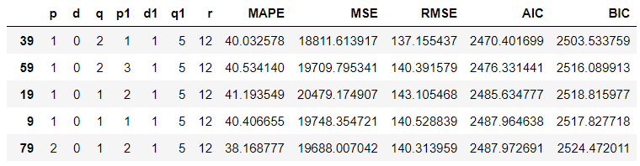
HYPERPARAMETER TUNING
WATER CONSUMPTION (TONS)
Tune the SARIMA Model for ‘Water Consumption (tons)’ by looping through p, d, q, r, p1, d1, q1 values and obtain the error metrics using validation data.
Sort the results obtained by increasing AIC values.
From the results, (1, 0, 2), (1, 1, 5, 12) provides the best AIC value of 2470.40. However, we will still analyse further before deciding on the optimal order.

Slide 31
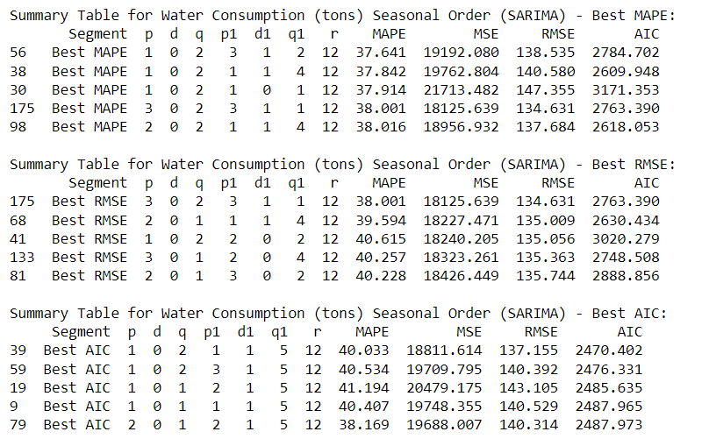
HYPERPARAMETER TUNING
WATER CONSUMPTION (TONS)
Further sort the tuned results by RMSE, MAPE and AIC.
From this table, we will still decide to keep the set of results with the lowest AIC of 2470.40 as the predicted and forecasted values best align with the actual values, even though its validation error rate is slightly higher at 40%.
With the objective being to accurately forecast future values, priority is still given to results that have the best predictive ability (defined by AIC).

Slide 32
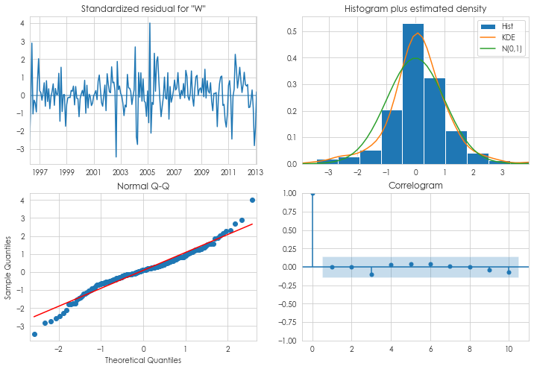
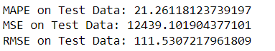
FINAL MODEL EVALUATION
WATER CONSUMPTION (TONS)
Evaluation Metrics :
From the evaluation metrics, we can see that the set order (1, 0, 2), (1, 1, 5, 12) was a good choice as error rate for MAPE is rather low at 21%.
This order result is optimal, as we see from the residual plot that it is randomized with no clear pattern, and most of the scatter points are found along the Normal Q-Q diagonal line, indicating that the residuals follow a normal distribution.

Slide 33

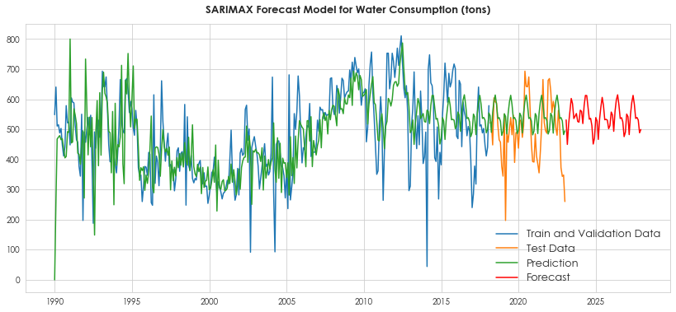
FINAL FORECAST MODEL
WATER CONSUMPTION (TONS)
Generate predictions using the tuned SARIMA model for the time range from 1990 to 2023.

Slide 34
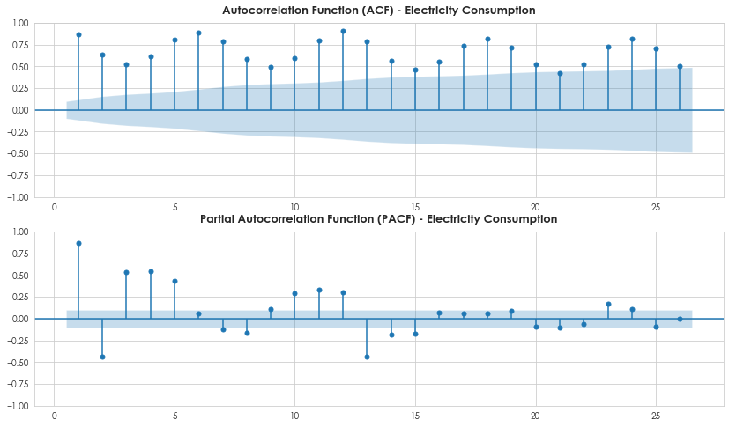
MODEL TESTING & SELECTION
ELECTRICITY CONSUMPTION (MWH)
The ACF plot determines the MA(q) process, and the PACF plot determines the AR(p) process.
From the ACF plot, there is no clear pattern and no significant spike at any lag, hence the best value for MA(q) would be inconclusive, indicating a weak moving average component.
From the PACF plot, it only has one clear significant spike at lag 1, indicating that an AR(1) process is suitable for electricity consumption.
So, the plots suggest p = 1. As for q, the best value would need to be determined with further analysis.

Slide 35

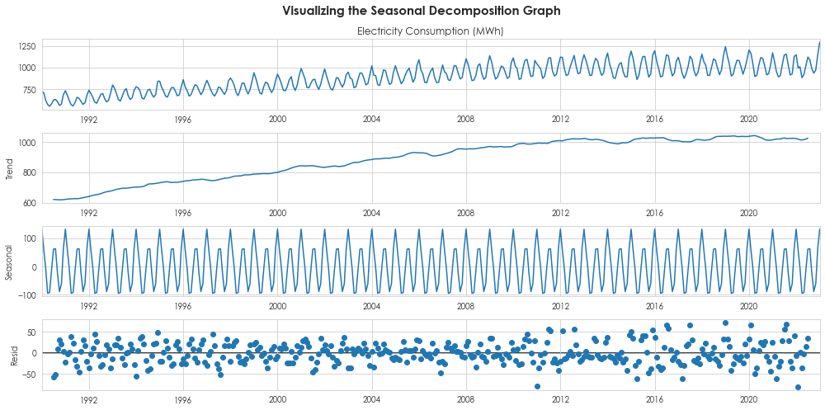
MODEL TESTING & SELECTION
ELECTRICITY CONSUMPTION (MWH)
To determine seasonality, use the ‘seasonal_decompose’ function to plot the seasonal decomposition plot.
Specify model as ‘additive’ as patterns in seasonality remain similar throughout for electricity consumption
Based on the seasonal plot, we can identify that the seasonal period for electricity consumption = 12. To validate this, we will plot an ACF seasonal plot next.

Slide 36

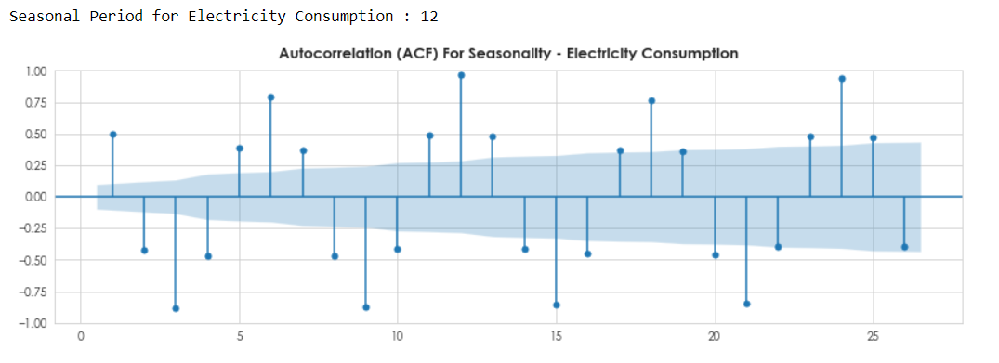
MODEL TESTING & SELECTION
ELECTRICITY CONSUMPTION (MWH)
For this plot, significant spikes that extend beyond the blue significance bands indicate the presence of seasonal patterns.
The plot shows that the spike occurs at period 12, indicating that the seasonal period for water consumption is indeed 12.
Plot a seasonal ACF plot to validate the seasonal period for electricity consumption.

Slide 37
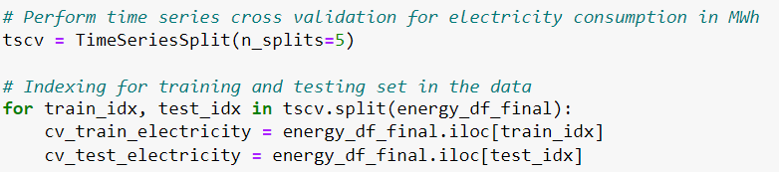
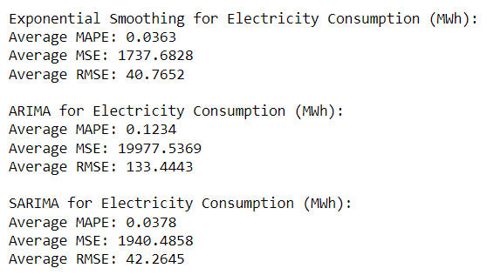
MODEL CROSS VALIDATION
ELECTRICITY CONSUMPTION (MWH)
To identify the most suitable model, use cross-validation (Time Series Split) where cv = 5 and retrieve the average error rates for each of the models.
Index and split the data into training and validation sets for cross-validation.
From the output, Holt-Winters Exponential Smoothing had the lowest error rates, with an MAPE of 0.0363, MSE of 1737.68, and RMSE of 40.76.

Slide 38
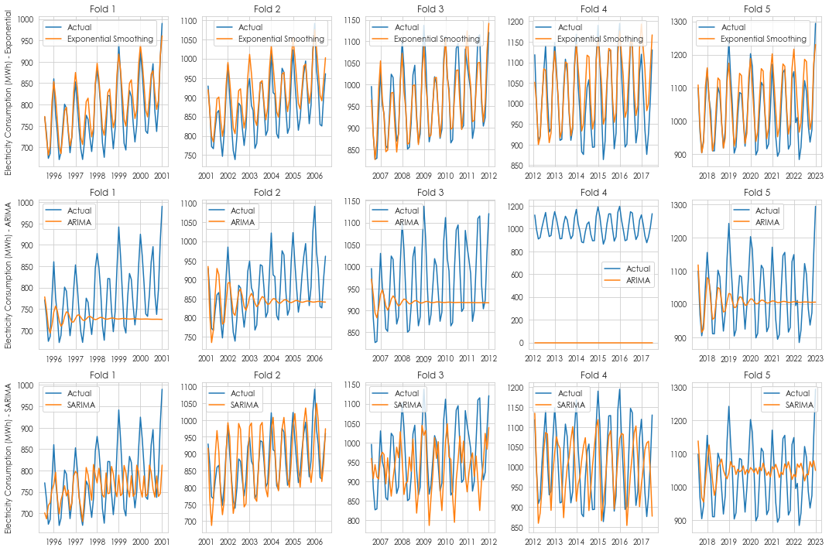
MODEL CROSS VALIDATION
ELECTRICITY CONSUMPTION (MWH)
From the plots, we see that the predicted values for Exponential Smoothing best align with the actual trends for water consumption, followed by SARIMA.
In this case, we will use Holt-Winters Exponential Smoothing as the predicted values best follow the trend of actual values, hence it shows that the Holt-Winters model is the best at forecasting for electricity consumption.

Slide 39

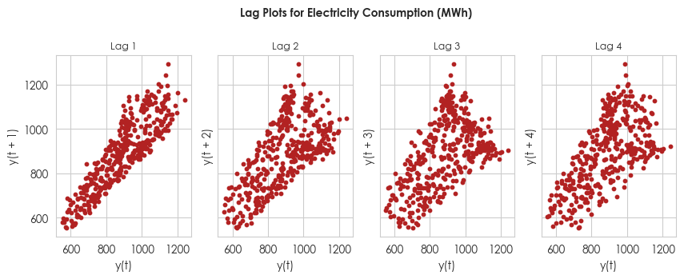
DETERMINE AUTOCORRELATION
ELECTRICITY CONSUMPTION (MWH)
To identify any recurring patterns or autocorrelation within the data, use lag plots to visualize the relationship at specified time intervals.
The lag plots prove that the gas consumption data has positive autocorrelation, as there is a positively sloped line for all the lag values for water consumption data.
Since the top of the points in the lag plot is bigger than the bottom, it suggests that data for electricity consumption is non-stationary as the variance of the data changed.

Slide 40

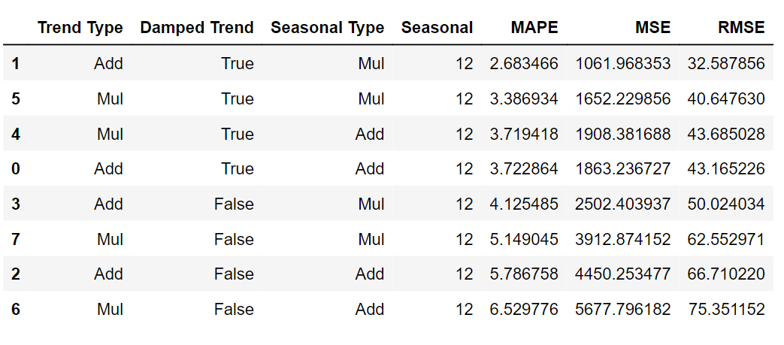
HYPERPARAMETER TUNING
ELECTRICITY CONSUMPTION (MWH)
Tune the Holt Winters Exponential Smoothing Model for ‘Electricity Consumption (MWh)’ by looping through trend_range, damped_trend_range, seasonal_range and seasonal values and obtain the error metrics using validation data.
Sort the results obtained by increasing MAPE values.
From the results, the following are the best parameters :
- Trend Type : Additive
- Damped Trend : True
- Seasonal Type : Multiplicative
- Seasonal : 12

Slide 41

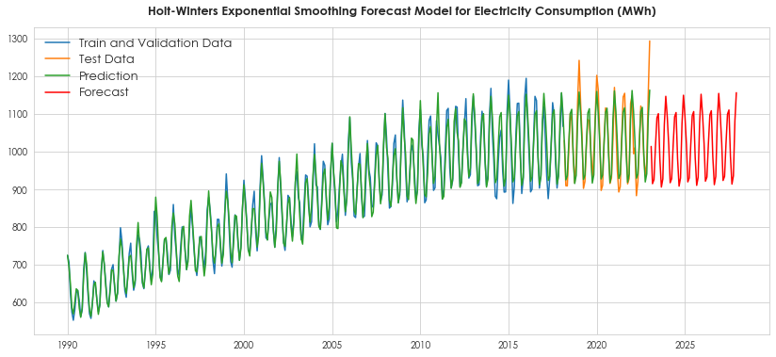
FINAL FORECAST MODEL
ELECTRICITY CONSUMPTION (MWH)
Fit and Predict using the tuned Exponential Smoothing model for the time range from 1990 to 2023.

Slide 42
CONCLUSIONS GAINED
GAS CONSUMPTION (TONS)
Best Prediction Model : SARIMA
Best Order Result : (2, 0, 2) , (1, 1, 5, 12) – (p,d,q) , (p1,d1,q1,r)
WATER CONSUMPTION (TONS)
Best Prediction Model : SARIMA
Best Order Result : (1, 0, 2) , (1, 1, 5, 12) – (p,d,q) , (p1,d1,q1,r)
ELECTRICITY CONSUMPTION (MWH)
Best Prediction Model : Holt-Winters Exponential Smoothing
Best Parameters : ‘trend = add; seasonal = mul; seasonal_periods = 12; damped_trend = True

